Slide 1

Customer Segmentation Analysis for KJ Marketing
GROUP MEMBERS -B16
1.Tehara De Silva
2.Kusalya Kaluthotage
3.Viveka Senaratne
4.Samod Amarasinghe

Slide 2
INTRODUCTION
KJ Marketing, a retail supermarket chain, wants to improve customer engagement by using
personalized marketing instead of traditional methods.
Using sales data from 22 outlets, this project analyzes customer shopping habits and
groups them based on three product categories:
Dry Goods – Non-perishable items like snacks and grains.
Fresh Produce – Perishable items like fruits and dairy.
Luxury Items – High-end products with premium quality.
The goal is to use customer data to create better marketing strategies and boost business growth.

Slide 3
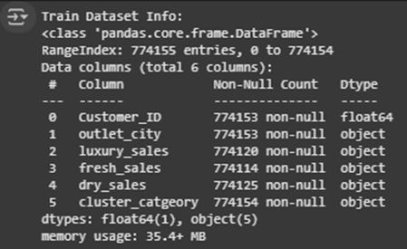
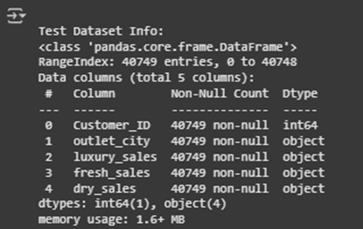
Research Overview & Data Exploration
•Objective: Segment customers for targeted marketing using data science techniques.
•Dataset Overview: 774,155 records (Train) & 40 749 records (Test)
•Key Features: luxury_sales, fresh_sales, dry_sales, outlet_city, customer_ID
•Exploratory Data Insights: Data had missing values, duplicates, and outliers
Sales features were right-skewed with extreme values

Slide 4
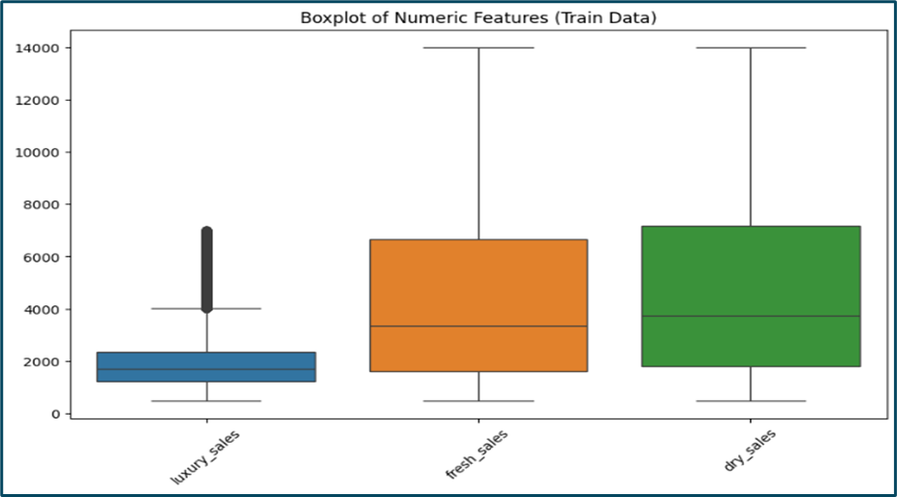
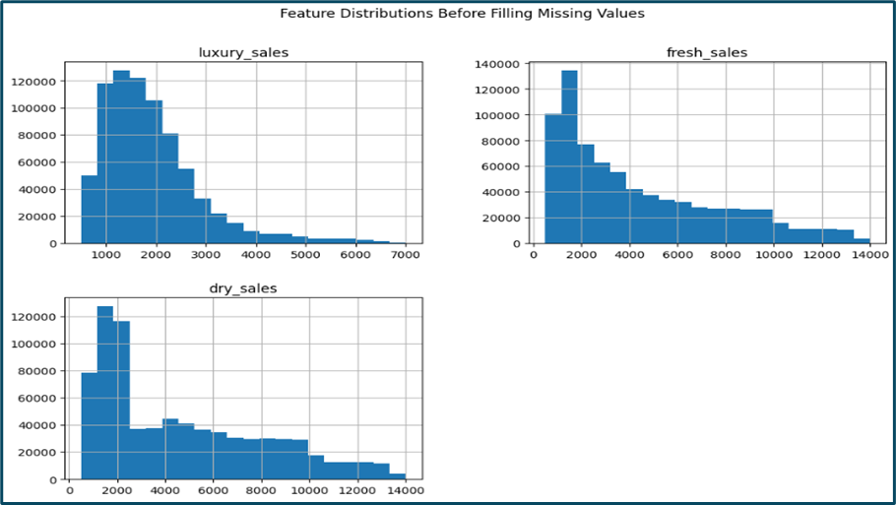
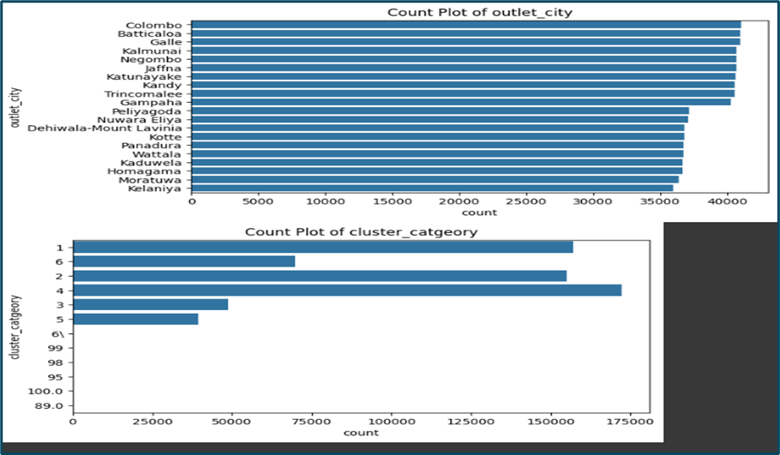
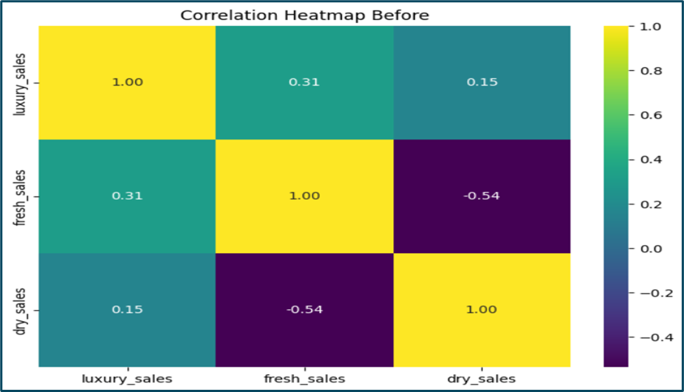

Slide 5
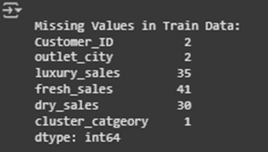
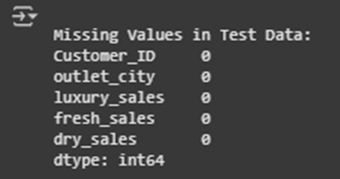
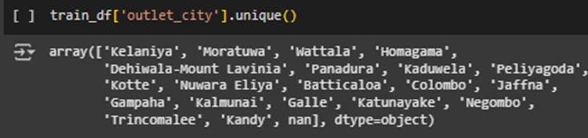
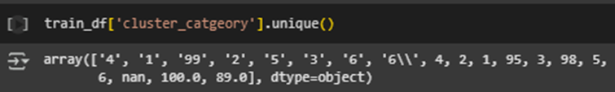
Data cleaning and preprocessing
Steps Taken:
•Handled Missing Values: Median for sales, mode for categorical
•Outliers Capped: Used IQR method to cap extreme values
•Converted Data Types:Sales columns converted from objects to numeric
•Removed Invalid Labels: Cluster categories 99, 98, 100 removed
•Standardized Outlet Names
•Key Outcome: Cleaner, consistent data ready for modeling

Slide 6
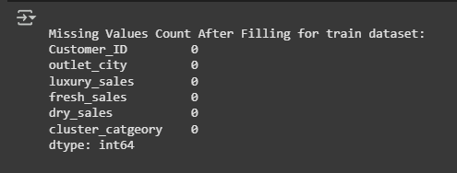
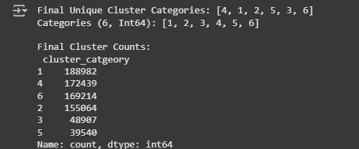
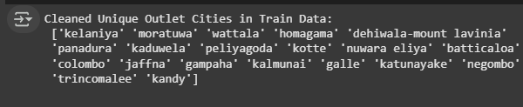
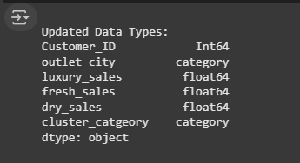
Data Values after Cleaning

Slide 7
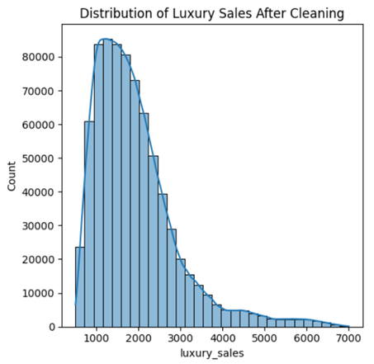
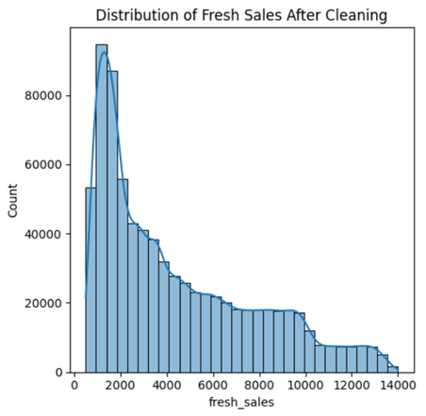
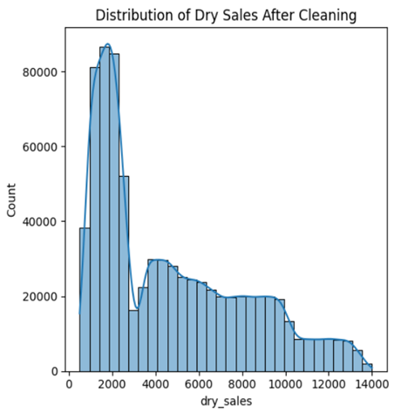
EDA AFTER CLEANING – KEY INSIGHTS
•Spending Behavior Insights:
Customers have distinct spending patterns across luxury, fresh, and dry sales
Some clusters show balanced spending, othersfavor specific product types
•City-wise Spending Trends:
Colombo, Jaffna, and Gampaha had the highest overall sales
Some cities had significantly higher luxury sales
•Dry & Feature Correlations:
Fresh Sales are negatively correlated (-0.54)
Luxury Sales show moderate positive correlation with Fresh Sales

Slide 8
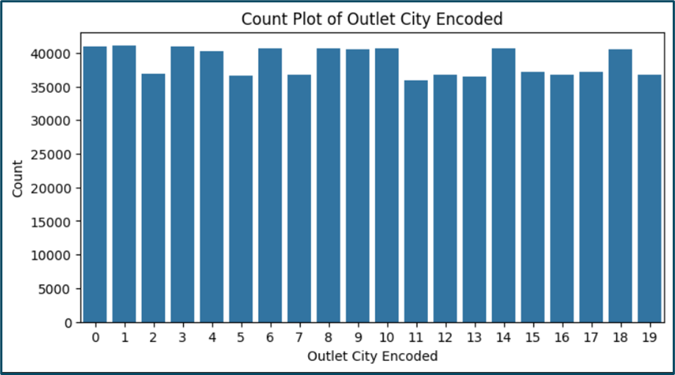
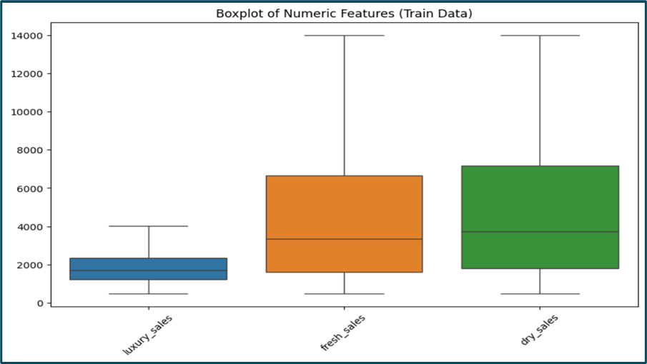
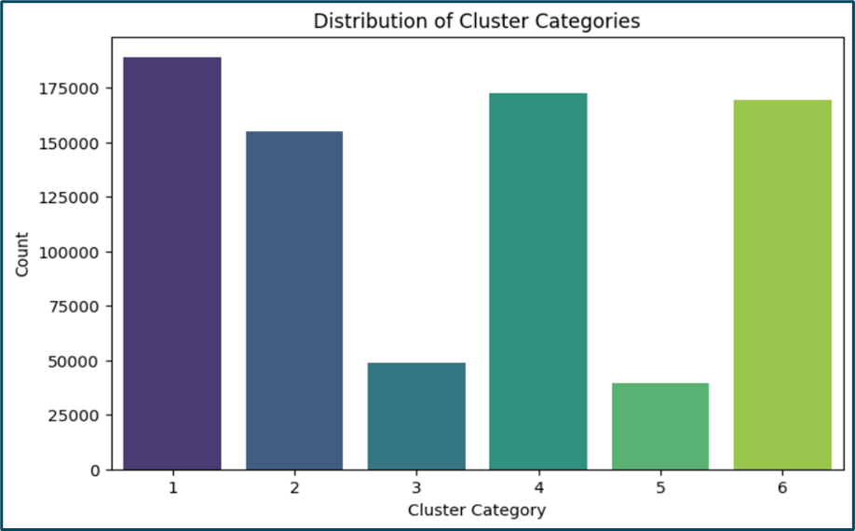
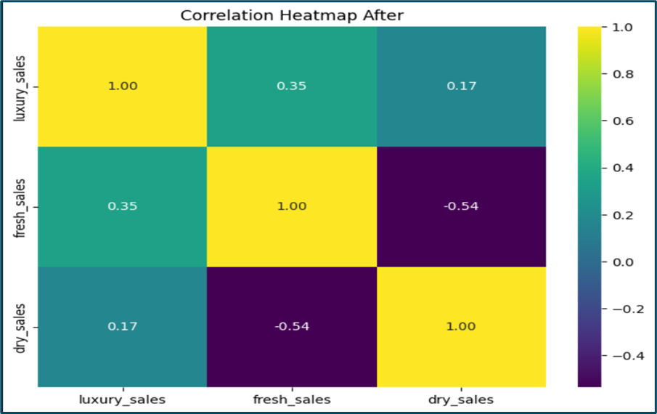

Slide 9

Feature engineering and transformation
Why Feature Engineering?
•Improved model accuracy by reducing skewness & standardizing scale
Techniques Used
Log Transformation: Applied to sales features to normalize distribution
Encoding: Label encoding
MinMax Scaling: Brought all features to a common range (0-1)
Feature Selection: Retained luxury_sales, fresh_sales, dry_sales, outlet_city_encoded
Impact
Models learned better & improved segmentation accuracy

Slide 10
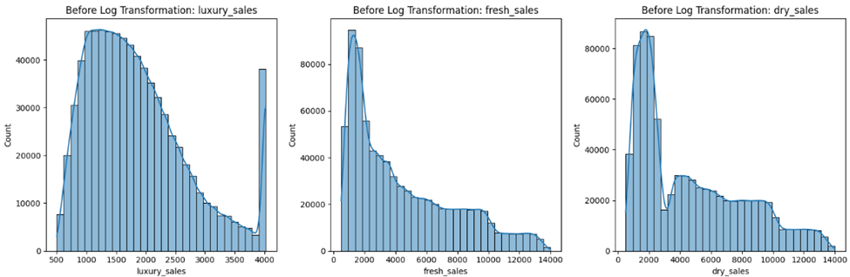
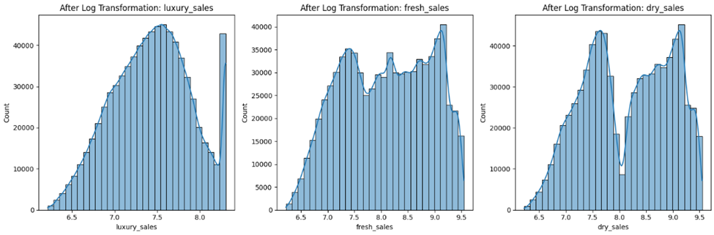
Log Transformation

Slide 11
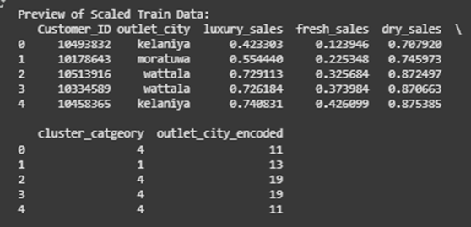
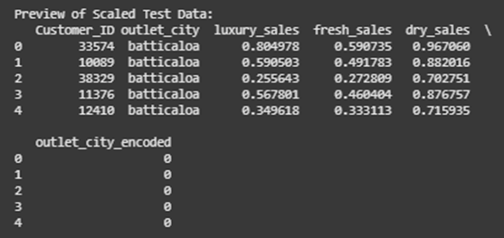
Feature Scaling
After transformation, numerical features were scaled to 0–1 using MinMaxScaler to standardize the data and ensure equal contribution to distance-based models.
Encoding & Feature Scaling
Only the essential features luxury_sales, fresh_sales, dry_sales, outlet_city_encoded were retained for modeling.

Slide 12
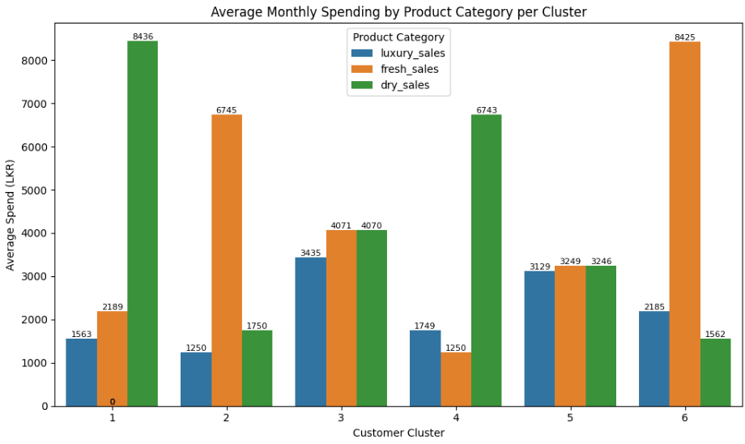
Customer Segments
Segment 1: Bulk Dry Buyers – High dry sales, moderate fresh and luxury; likely bulk buyers of non-perishables.
• Segment 2: Fresh-Focused Shoppers – High fresh sales, lower in other categories; focused on perishables.
• Segment 3: Premium All-Round Shoppers – High across all categories; likely high-value, premium customers.
• Segment 4: Moderate Dry Sales Shoppers – Dominated by dry sales, low fresh and luxury; likely cost-conscious bulk buyers.
• Segment 5: Balanced Budget Shoppers – Even but lower spending across all; likely budget-conscious.
• Segment 6: Luxury & Fresh-Oriented Shoppers – High fresh, moderate luxury, low dry; focused on premium perishables.

Slide 13
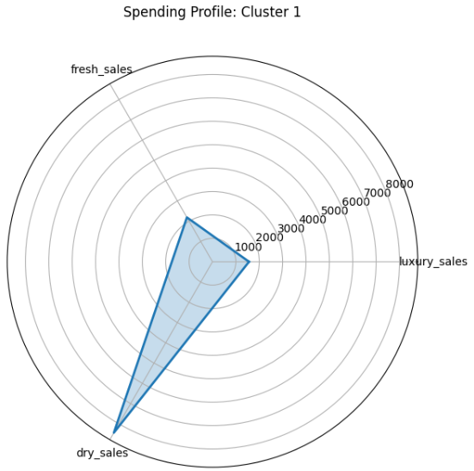
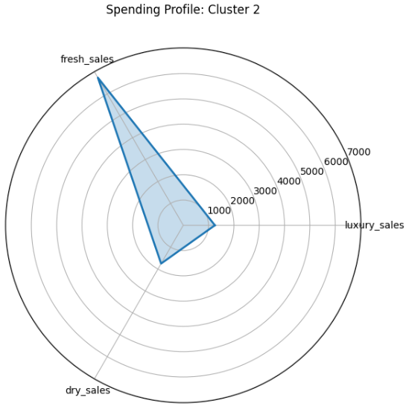
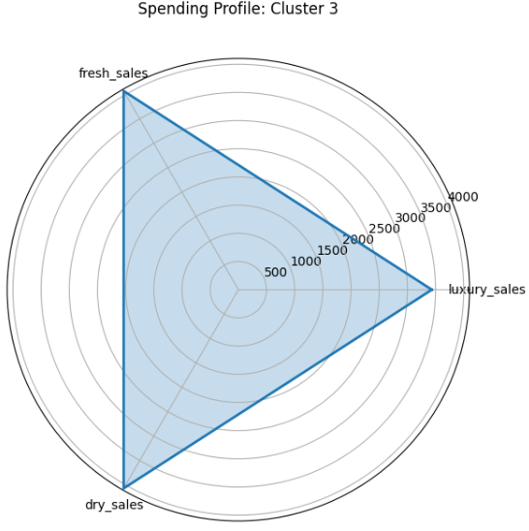
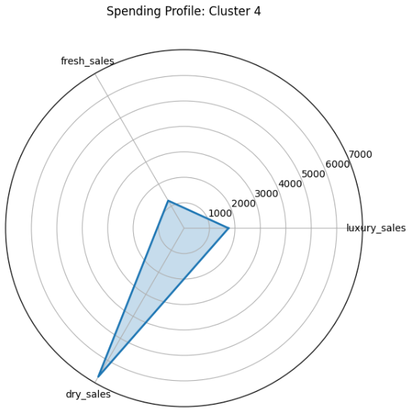
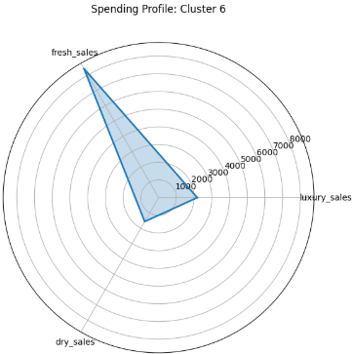
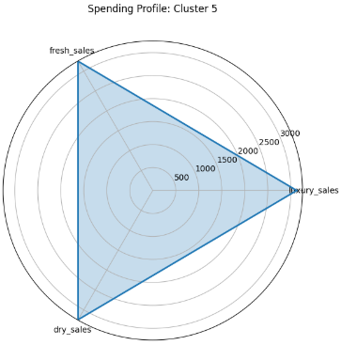

Slide 14
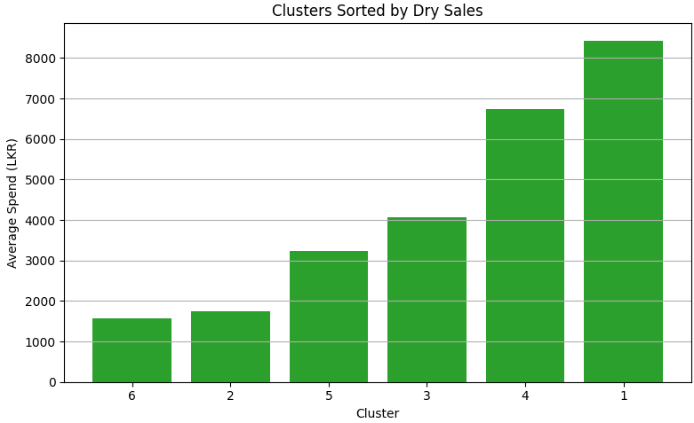
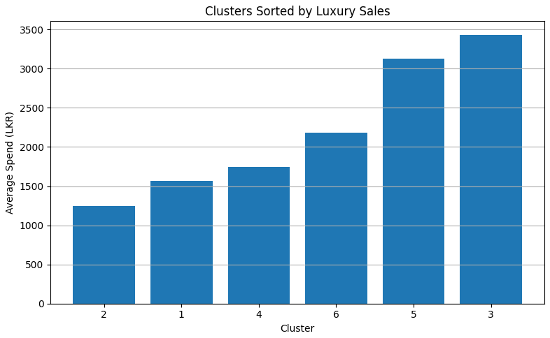
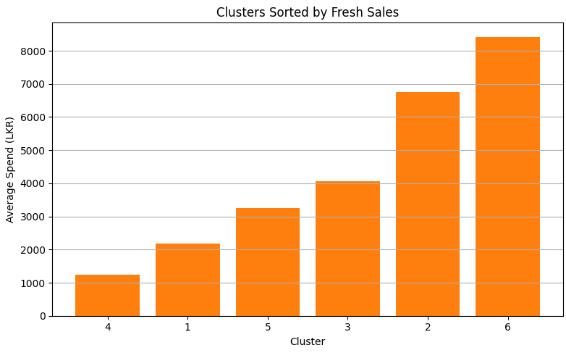

Slide 15
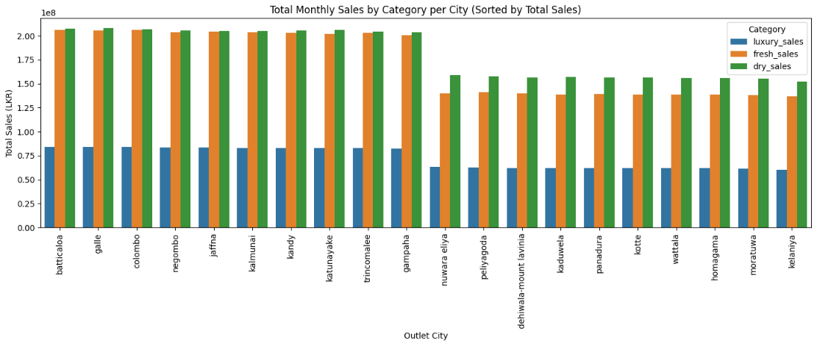

Slide 16
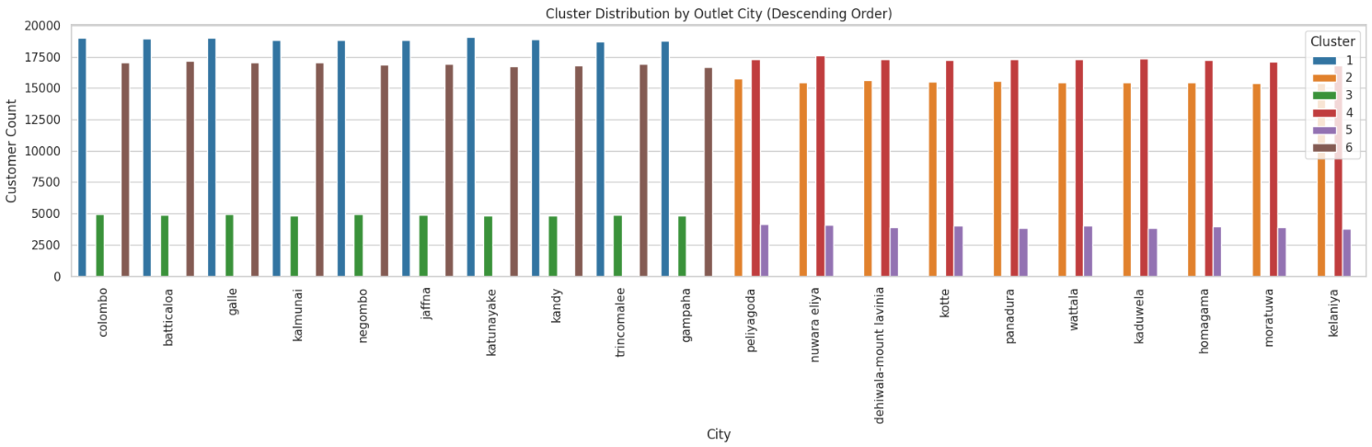
Cities are sorted by total customer count for better clarity on market size.
Colombo, Batticaloa, Galle are top-performing cities with high presence of Clusters 1 and 6.
Kelaniya, Moratuwa, Homagama have a higher concentration of Clusters 2 and 5, indicating a different customer base.
This visualization helps prioritize regional marketing and resource allocation based on customer density and cluster dominance.
Encourages location-specific targeting to match cluster preferences and maximize outreach impact.

Slide 17
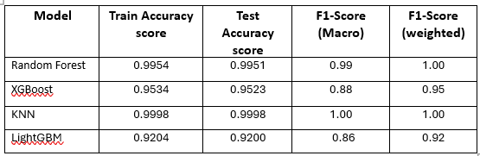
Model selection and training
Models Considered:
Random Forest: A robust and interpretable model, ideal for handling structured data.
XGBoost: High-performance boosting algorithm, effective on imbalanced datasets.
KNN: A simple, intuitive baseline that classifies based on feature proximity.
LightGBM: Fast, scalable gradient boosting optimized for large datasets.

Slide 18
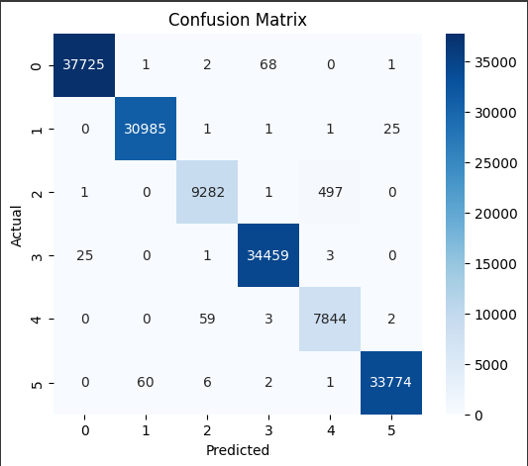
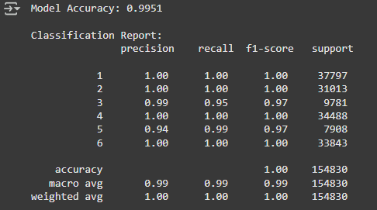
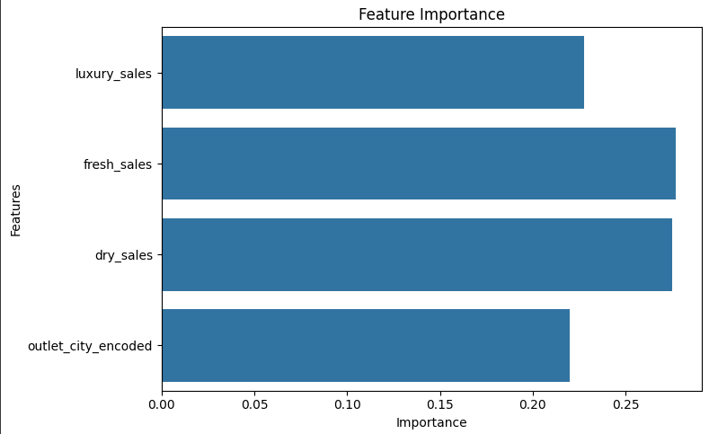
Random Forest Model
Achieved 99.51% test accuracy with high F1-scores across all clusters
Excellent performance on majority clusters (1, 2, 4, 6)
Feature importance showed dry_sales and fresh_sales as top predictors
Slight risk of overfitting due to near-perfect performance
Lacked flexibility in handling class imbalance compared to XGBoost

Slide 19
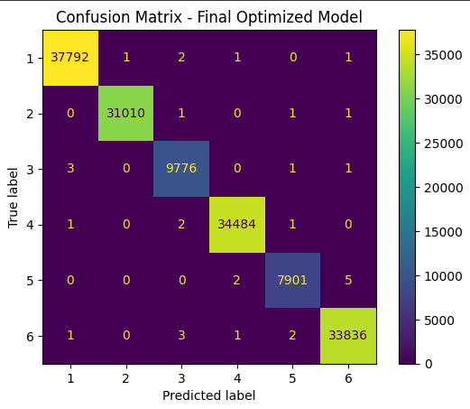
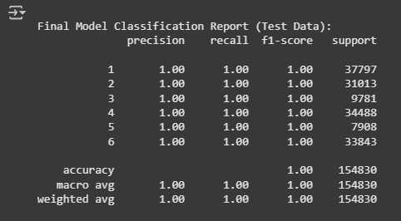
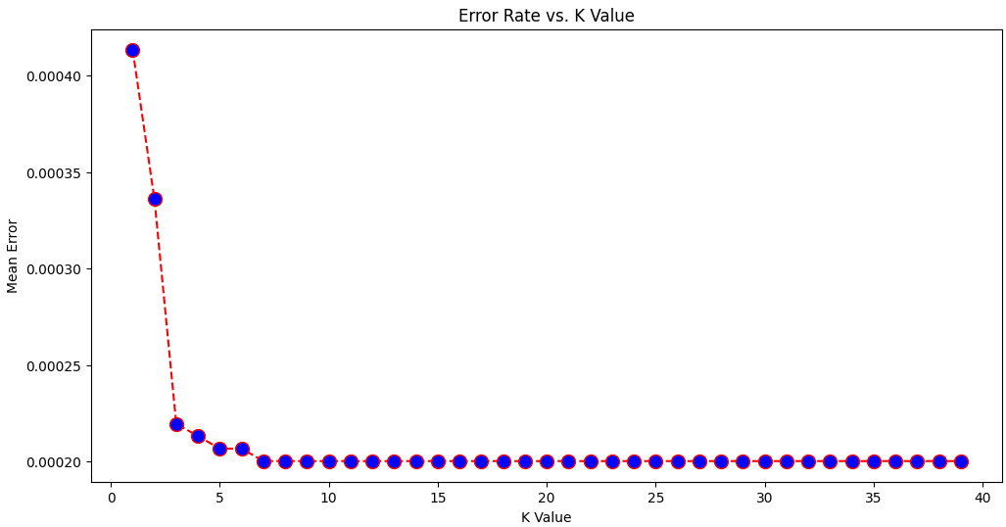
KNN- Model
Achieved 100% accuracy on both training and test data.
All metrics (precision, recall, F1-score) are perfect but is typically unrealistic for real-world data.
The confusion matrix shows almost zero misclassifications across all classes.
Error rate drops significantly at lower K values and stabilizes around K = 7.
Despite strong performance, overfitting risk and scalability concerns make it less suitable for deployment.

Slide 20
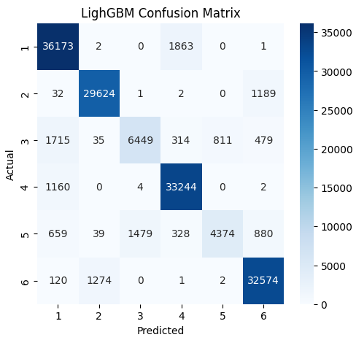
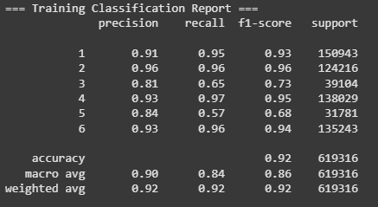
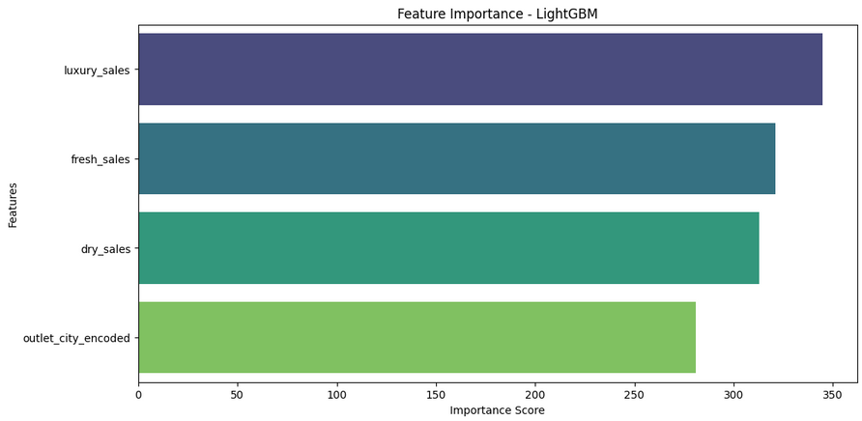
LightGBM Model
Accuracy: Achieved a decent training accuracy of 92%.
Recall: Some classes (like Class 5) had lower recall, indicating weaker performance on minority groups.
Precision & F1-score: Overall good, but not as high or balanced as Random Forest or XGBoost.
Feature Importance: luxury_sales was the most influential feature, followed by fresh_sales.
Conclusion: Fast and scalable model, but not selected due to slightly lower class-wise performance and sensitivity to imbalance.

Slide 21
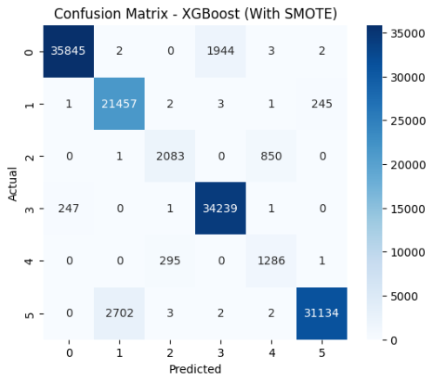
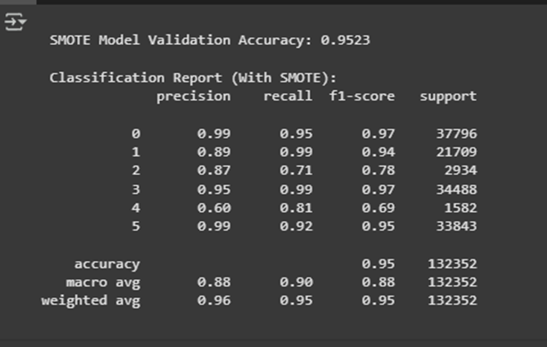
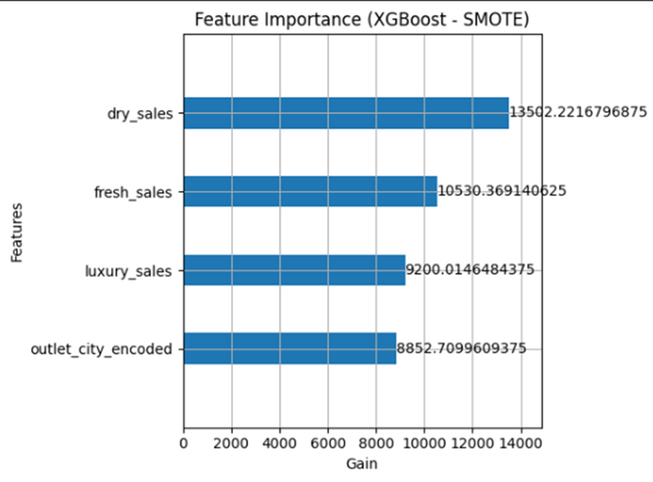

Final Model – XGBoost
Balanced performance: Achieved 95.23% validation accuracy
Improved recall on minority clusters using SMOTE (equal distribution across all classes)
Overall model is more fair and generalizable
Top features influencing predictions: dry_sales, fresh_sales, and luxury_sales
Selected for final deployment due to strong generalization and business alignment

Slide 22




XGBoost comparison (imbalanced data, class weights, and SMOTE)
Imbalanced Data: Struggled with minority class predictions (e.g., class 4 and 5 had high misclassification).
SMOTE: Provided the best overall balance, significantly improving recall for underrepresented classes

Slide 23
Strategic Business Recommendations
•How KJ Marketing Can Leverage This Model:
Personalized marketing – Target promotions based on cluster spending habits
Optimized resource allocation – Focus budget on high-value clusters
Product assortment decisions – Stock stores based on location-wise demand
Predict future trends – Use ongoing data to improve segmentation
Next Steps:
Deploy the model in real-time customer segmentation
Integrate findings with marketing automation tools
Continuously refine model based on new data

Slide 24
Personalized Marketing Campaigns
Tailor promotions and product recommendations based on cluster-specific spending habits:
Cluster 1 & 4: High spenders on dry_sales – promote bulk or loyalty discounts.
Cluster 3 & 5: Balance spending across all categories – ideal for cross-selling.
Cluster 2: Heavy fresh_sales buyers – use freshness and seasonal campaigns.
Cluster 6: Strong luxury preference – ideal for premium product upselling.

Slide 25
City-wise Campaign Targeting
Use the city-wise cluster distribution to launch location-specific promotions:
Focus luxury product ads in cities with a higher concentration of Cluster 6.
Run dry goods bundles in areas dominated by Clusters 1 and 4.
Rebalance store inventory based on dominant clusters in each outlet city.

Slide 26
Informed Product Mix Decisions
Adjust product assortment across stores:
Outlet locations with more Cluster 2 members should stock more fresh products.
Prioritize luxury products in Cluster 6 areas and promotional bundles in Cluster 3.
Predict Future Trends
By retraining the model on new data, the business can track evolving cluster behavior and spot emerging patterns (e.g., growth in luxury interest or seasonal shifts).
Optimized Resource Allocation
Allocate marketing budgets and loyalty programs toward clusters that generate the highest total revenue and customer volume (e.g., Clusters 1 & 6). This maximizes ROI on promotions.

Slide 27
Thank you!

Slide 28

Workload Martix

